Slide 1
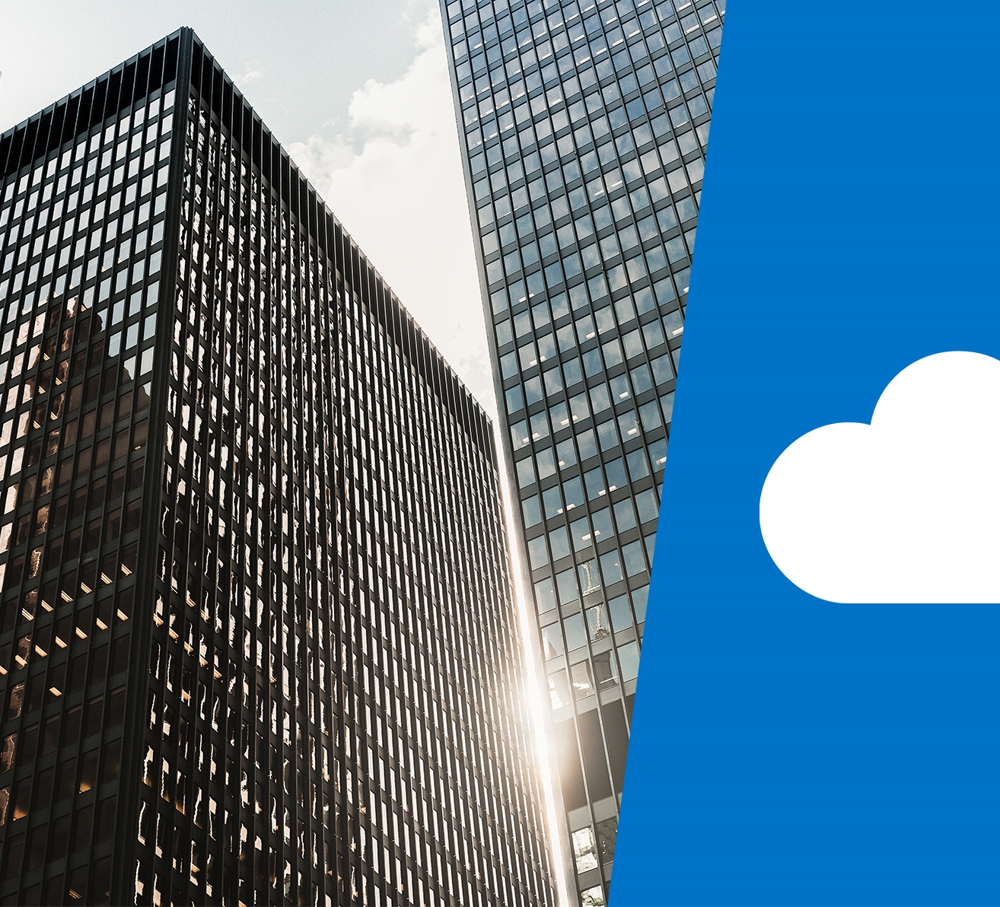
DP-201T03: Azure Real-Time Processing Reference Architectures

Slide 2
Lesson Objectives
Lambda architectures for a Real-Time Mode Perspective
Architect a stream processing pipeline with Azure Stream Analytics
Design a stream processing pipeline with Azure Databricks
Create an Azure IoT reference architecture

Slide 3
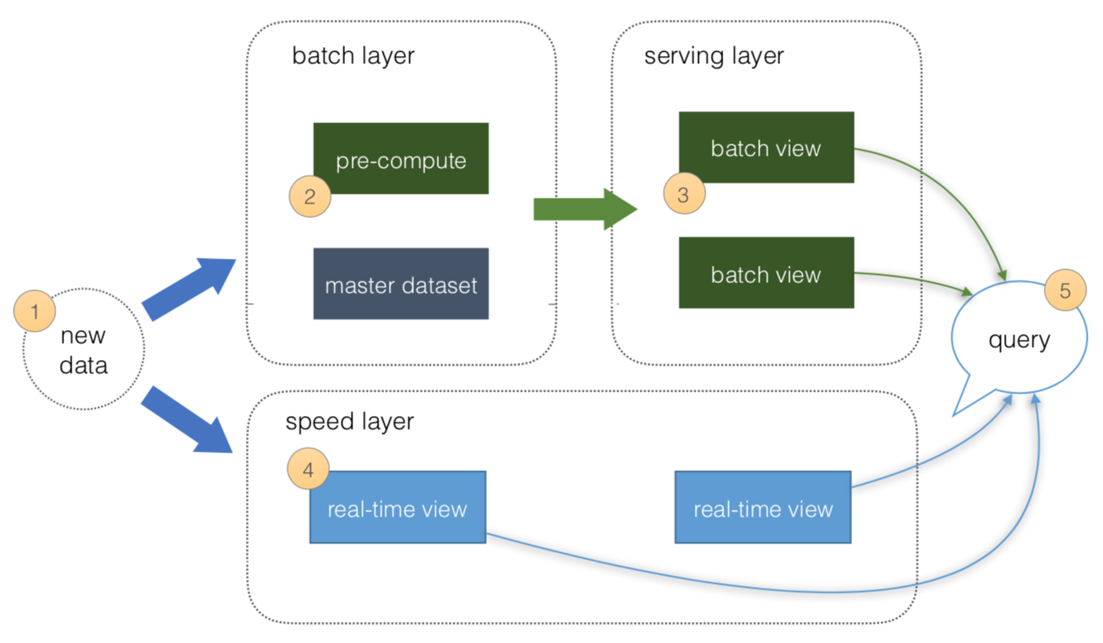
Lambda architectures from a real time mode perspective
Speed Layer
The Speed layer processes data streams in real or near real time. This works well when the aim is to minimize the latency of the data ingestion to analysis.
New data ingested from sources
4. Real time views of the data created.
Serving Layer
The serving layer is optional in the real-time architecture and acts as the storage output of either the Batch or Speed layer that is used by client applications to access the results of the data-sets.
Notes:
Lambda Architecture - Speed Layer
The Speed layer processes data streams in real or near real time.
This works well when the aim is to minimize the latency of the data ingestion to analysis.
However, the cost of this is that there are no opportunities to clean or fix the data.
It enables the organization to get a real time view of the data and can be used to fill in the gap of information until the batch data is processed.

Slide 4
Data in Motion
Real-time message ingestion.
Capture and store real-time messages for stream processing.
This might be a simple data store, where incoming messages are dropped into a folder for processing.
Many solutions need a message ingestion store to act as a buffer for messages, and to support scale-out processing, reliable delivery, and other message queuing semantics.
Stream processing.
Solution must process messages by filtering, aggregating, and preparing the data for analysis.
The processed stream data is then written to an output sink.

Slide 5
Azure Technologies for Lambda Architecture
Real-time message ingestion
Event Hubs / IoT Hubs
Azure Kafka (Kafka as a managed service)
Confluent Cloud (Kafka as a managed service)
Stream processing.
Azure Stream Analytics (perpetually running SQL queries on unbounded streams)
Azure Databricks
Spark HDInsight (Hortonworks)
Storm on HDInsight

Slide 6
Non-Azure Popular Streaming Technologies
Open Source
Apache Kafka
Apache Flink (trendy)
Apache Beam
AWS Kinesis
AWS MKS (Kafka as a service)
Confluent Cloud on AWS and GCP
Google Cloud Pub/Sub
Google Cloud Dataflow

Slide 7
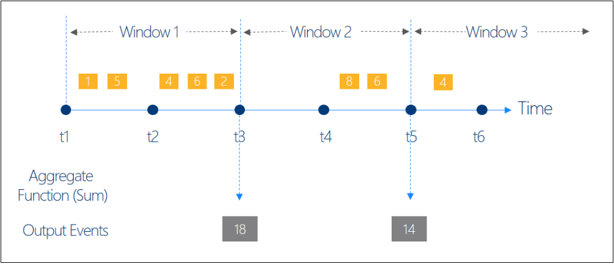
Stream Analytics Windowing
All the windowing operations output results at the end of the window.
The output of the window will be single event based on the aggregate function used.
The output event will have the time stamp of the end of the window and all window functions are defined with a fixed length.
Notes:
Instructor notes
This space has been left deliberately blank.

Slide 8
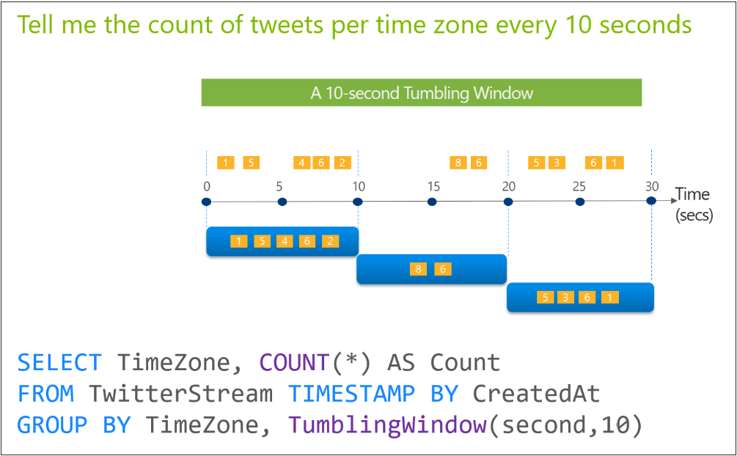
Tumbling window
Notes:
Instructor notes
This space has been left deliberately blank.

Slide 9
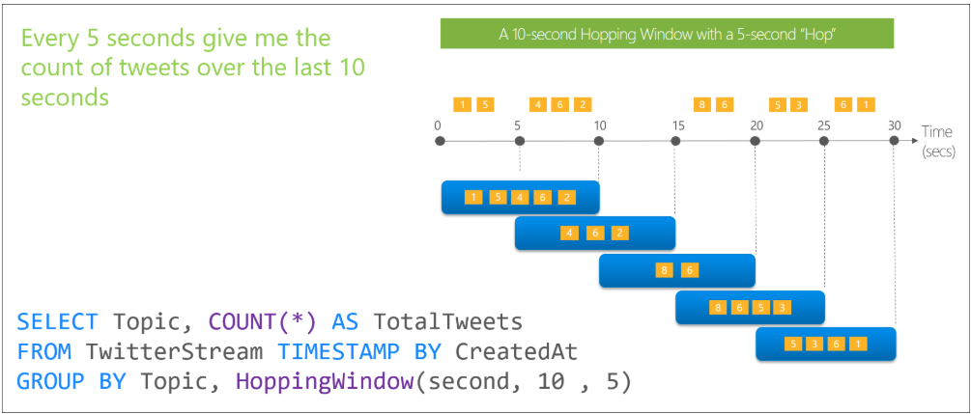
Hopping window
Notes:
Instructor notes
This space has been left deliberately blank.

Slide 10
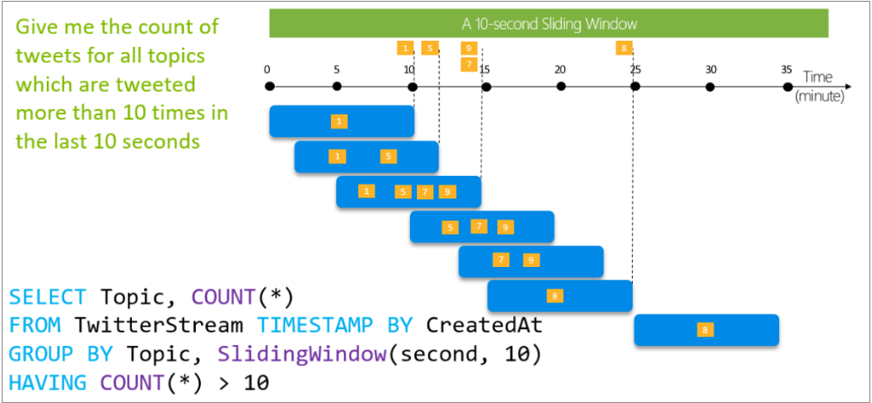
Sliding window
Produce an output only when an event occurs
Notes:
Instructor notes
This space has been left deliberately blank.

Slide 11
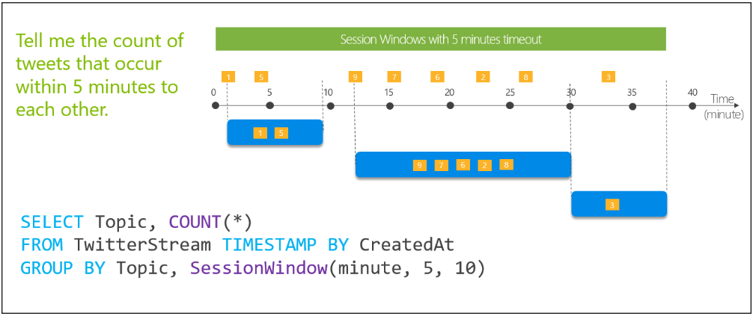
Session window
Group events that arrive at similar times, filtering out periods of time where there is no data.
Notes:
Instructor notes
This space has been left deliberately blank.

Slide 12
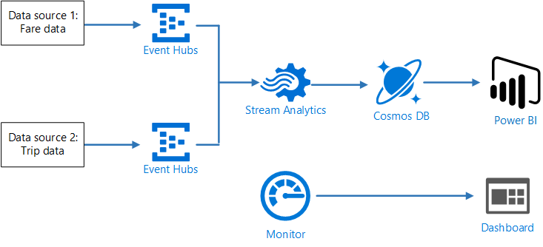
Architect a stream processing pipeline with Azure Stream Analytics
Taxi Cab app
Notes:
In this architecture, there are two data sources that generate data streams in real time.
The first stream contains ride information, and the second contains fare information. This is generated in real time by an application within the taxi cab.
Azure Event Hubs is a Big Data streaming platform and event ingestion service, capable of receiving and processing millions of events per second. it is one of three supported data sources for Azure Stream Analytics. The others being IoT Hub and Azure Blob Store.
Analysis and Visualization
A Stream Analytics job is created that contains the Event Hubs as input streams, with a query that performs stream processing of the two event hubs to correlate the records in the two data streams.
An output is defined to Cosmos DB that stores the correlated results written as JSON documents to a Cosmos DB document database.
Power BI then uses Cosmos DB as a source for a dashboard of the correlated records.
You could also have Power BI point directly from Stream Analytics; however, this data would not be persisted in a data store

Slide 13
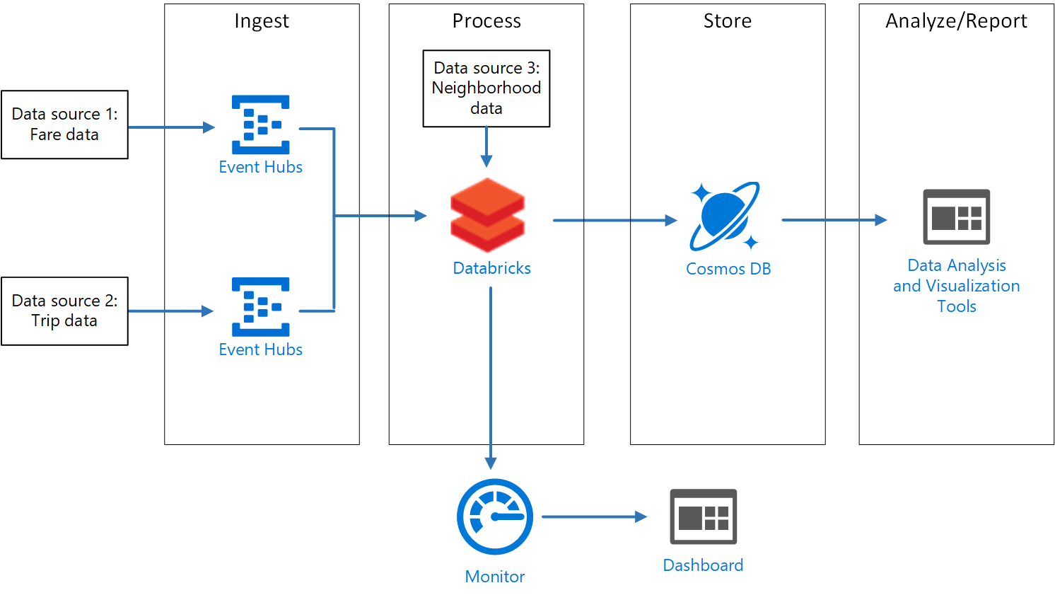
Design a stream processing pipeline with Azure Databricks
Cassandra API for time series data storage
Notes:
In this example, the pipeline ingests data from two sources, correlates records in the two streams, and performs a join on the related data streams.
The results are stored for further analysis that go beyond the capabilities of Stream Analytics and enables Data Science experiments to be performed on the data using Azure Databricks.
Ingestion and Data Storage
Each data source sends a stream of data to an associated Azure Event Hub.
It is then connected to Azure Databricks, which outputs its analyzed data into an Azure Cosmos DB using the Cassandra API.
The Cassandra API is used because it supports time series data modeling which can be used in the analysis of the trip and fare data
Analysis and Visualization
The analysis of the streaming data is performed with Azure Databricks, used to correlate the taxi ride and fare data, and also to enrich the correlated data with neighborhood data stored in the Databricks file system.
Additional technologies
Application log data collected by Azure Monitor is stored in a Log Analytics workspace

Slide 14
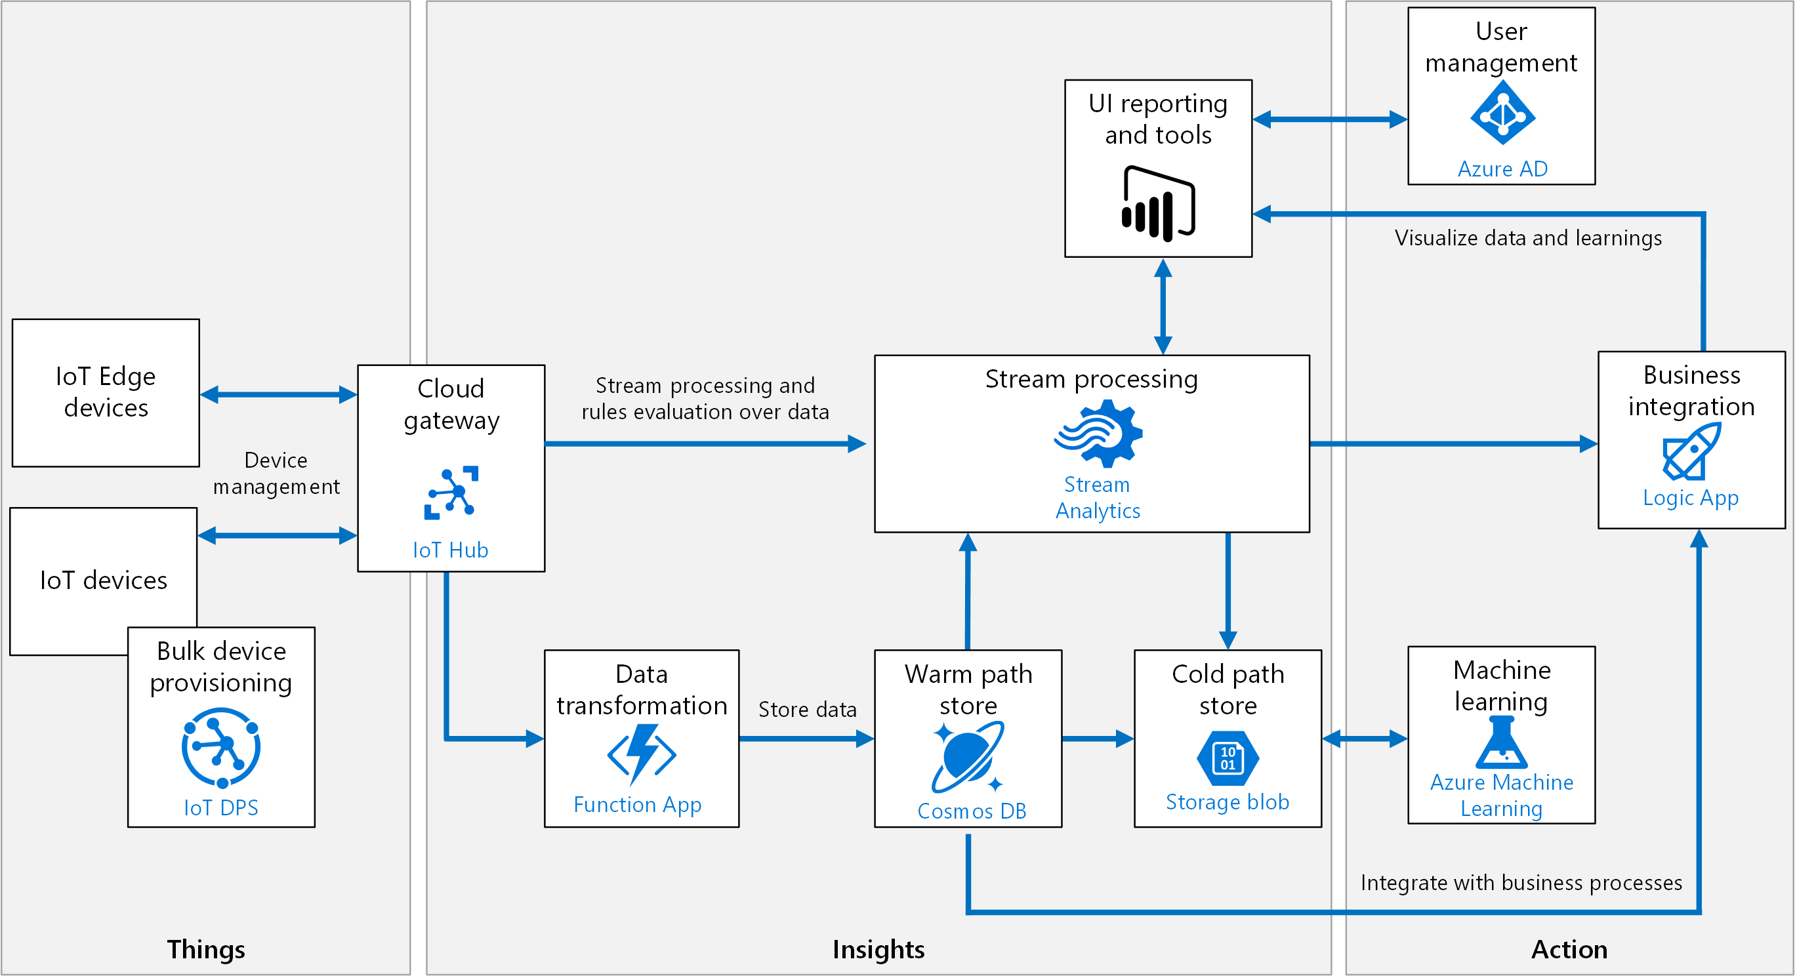
Create an Azure IoT reference architecture
Notes:
The are two types of devices. IoT devices and IoT edge devices.
Typically, IoT devices are constantly connected to the cloud which provides the capability to perform data processing and analysis in Azure.
Edge IoT devices contain some processing and analysis logic within the IoT edge device so that there is no dependency on a constant connection to the cloud
For example, a ship travelling through an ocean where there is no connectivity.
Ingestion and Data Storage
A cloud gateway provides a cloud hub for devices to connect securely to the cloud and send data.
It also provides device management, capabilities, including command and control of devices.
The hot path analyzes data in near-real-time, as it arrives. In the hot path, telemetry must be processed with very low latency. The hot path is typically implemented using a stream processing engine.
The output may trigger an alert or be written to a structured format that can be queried using analytical tools.
The data storage for this data is typically place in a data store that is highly responsive and available. This makes Azure Cosmos DB a great choice to store hot path data
In the cold path, raw telemetry is captured and then fed into a batch process. The data storage for this data is typically place in a data store that does not need to be queried directly, and does not need to be responsive in real-time. Azure Blob or Data Lake Store Gen II are useful data store in this scenario.
Analysis and Visualization
Stream Analytics job is created that contains the IoT Hubs as input streams, with a query that performs stream processing of the data streams. An output is defined to Cosmos DB that stores the results written as JSON documents to a Cosmos DB document database. As an alternative to Stream Analytics, another option is Apache Spark on Azure Databricks.
From a batch mode analysis perspective, the data in Azure Blob works with Machine Learning Services to allow predictive algorithms to be executed over historical telemetry data, useful in scenarios such as predictive maintenance.
Power BI is used to visualize the data directly from Stream Analytics.
Additional technologies
The Azure Functions outlined in the architecture perform data transformation that manipulates or aggregates the telemetry stream. Examples of transformation include protocol transformation, such as converting binary data to JSON, or combining data points. Azure Functions built-in integration with IoT Hub, Cosmos DB, and Blob Storage.
Azure Logic Apps can be used for business process integration which can include performing actions based on insights from the device data. This could include storing informational messages, raising alarms, sending email or SMS messages, or integrating with CRM. Azure Active Directory is used to authenticate and authorize users.

Slide 15
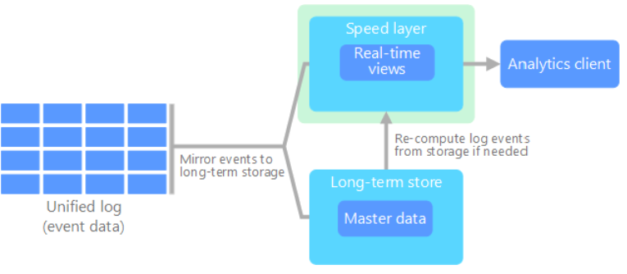
Kappa architecture
Lambda leads to duplicate computation logic and complex architecture for both paths.
Kappa architecture has the same basic goals, but with an important distinction
All data flows through a single path, using a stream processing system.
Data is ingested as a stream of events into a distributed and fault tolerant unified log.
If needed, you simply replay the stream.
Notes:
There are some similarities to the lambda architecture's batch layer, in that the event data is immutable and all of it is collected, instead of a subset. The data is ingested as a stream of events into a distributed and fault tolerant unified log.
These events are ordered, and the current state of an event is changed only by a new event being appended.
Similar to a lambda architecture's speed layer, all event processing is performed on the input stream and persisted as a real-time view.
If you need to recompute the entire data set (equivalent to what the batch layer does in lambda), you simply replay the stream, typically using parallelism to complete the computation in a timely fashion.

Slide 16
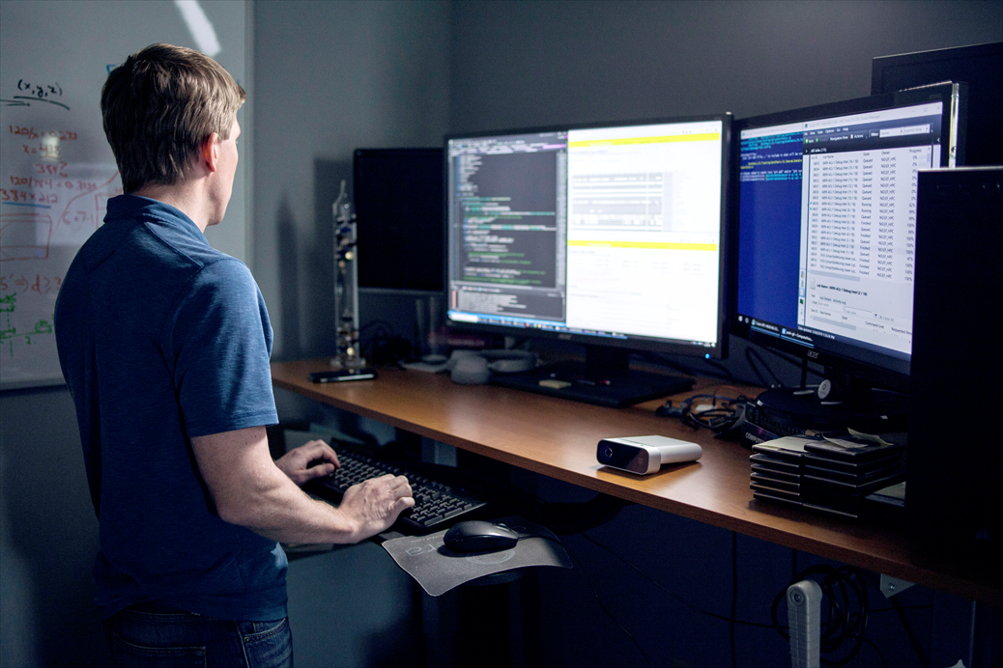
Lab: Azure Real-Time Processing Reference Architectures

Slide 17
Lab overview
The students will use the case study to identify which business and technical requirements relate to a Lambda architecture from a real-time perspective. The student will then architect a streaming pipeline with Azure Stream Analytics and Azure Databricks. Finally, the students will attempt to design an IoT architecture as it relates to the meeting of the AdventureWorks business requirements.
Lab objectives
After completing this lab, you will be able to:
1. Architect a stream processing pipeline with Azure Stream Analytics
2. Design a stream processing pipeline with Azure Databricks.
3. Create an Azure IoT reference architecture

Slide 18
Lab scenario
You are the senior data engineer of AdventureWorks. You are designing and architecting a solution that will deal with the real-time processing of data. You have been advised that the solution architecture should take a holistic view of all the business requirements and your proposal should be presented in a Word document.
You will first identify which AdventureWorks requirements fits into real-time processing of a Lambda architecture. You will then provide an architecture for a stream processing pipeline with Azure Stream Analytics and Azure Databricks. You will also design a first pass on an IoT architecture.
After completing this lab, you will be able to:
1. Architect a stream processing pipeline with Azure Stream Analytics
2. Design a stream processing pipeline with Azure Databricks.
3. Create an Azure IoT reference architecture

Slide 19
Lab review
Exercise 1 – Review the architectures
Exercise 2 – Are there any differences in architectures between groups?
Exercise 3 – How does the holistic architecture for real-time processing looks?

Slide 20
Lab review
Exercise 1 - Task 1: Design a real-time solution in Azure.
# | Requirement | Technology Suggestion
1 | Performing analysis of real-time social media data (Exercise 1 – Task 2) | ? ?
2 | Connected bicycle streaming data (Exercise 2 – Task 1) | ? ?
3 | Performing predictive analytics of bicycle maintenance (Exercise 2 – Task 1) | ? ?

Slide 21
Lab review
Exercise 1 - Task 1: Design a real-time solution in Azure.
# | Requirement | Technology Suggestion
1 | Performing analysis of real-time social media data (Exercise 1 – Task 2) | Event Hub Stream Analytics
2 | Connected bicycle streaming data (Exercise 2 – Task 1) | IoT Hubs. Stream Analytics
3 | Performing predictive analytics of bicycle maintenance (Exercise 2 – Task 1) | IoT Hubs. Azure Databricks

Slide 22
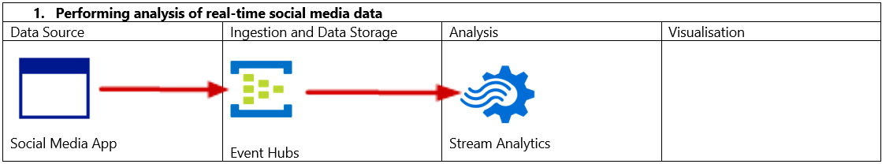
Lab review
Exercise 1 - Task 2: Build a high-level architecture that reflects a stream processing pipeline with Azure Stream Analytics.

Slide 23
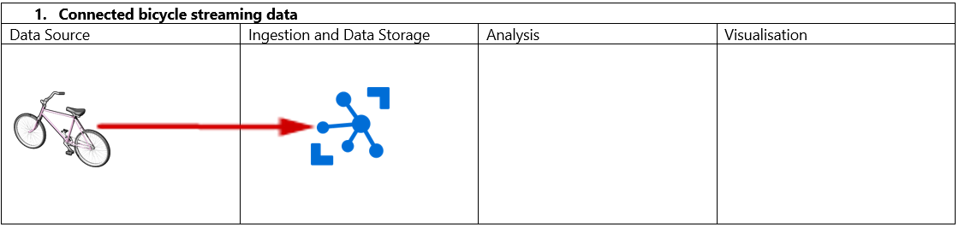
Lab review
Exercise 2 - Task 1: Create a high-level architecture to include a stream processing pipeline with Azure Databricks

Slide 24
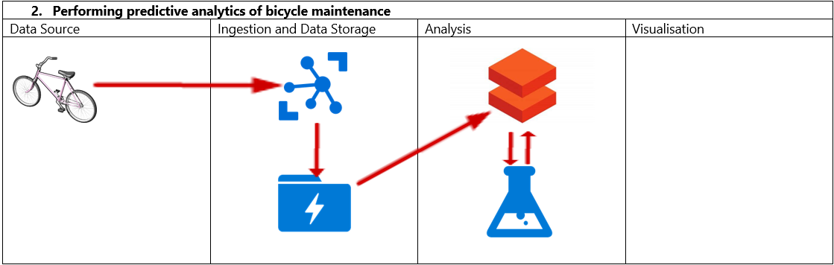
Lab review
Exercise 2 - Task 1: Create a high-level architecture to include a stream processing pipeline with Azure Databricks

Slide 25
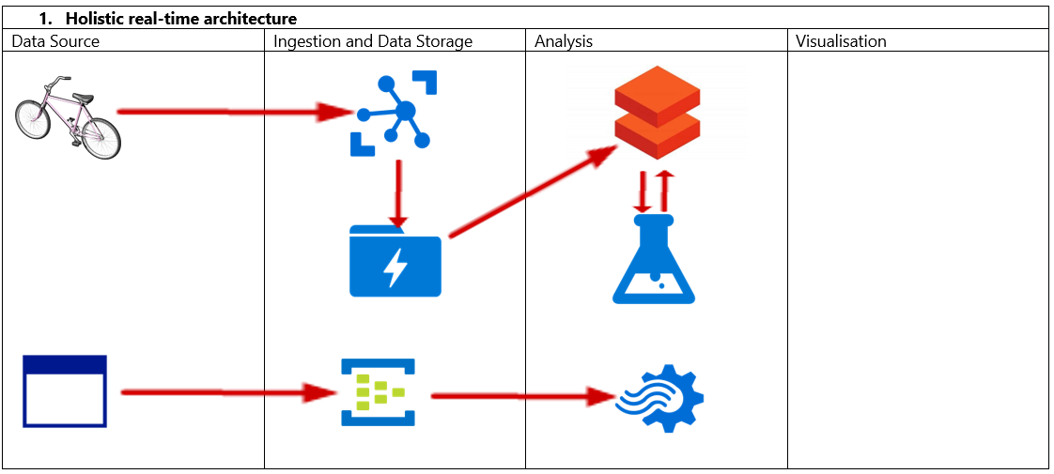
Lab review
Exercise 2 - Task 1: Create a high-level architecture to include a stream processing pipeline with Databricks

Slide 26
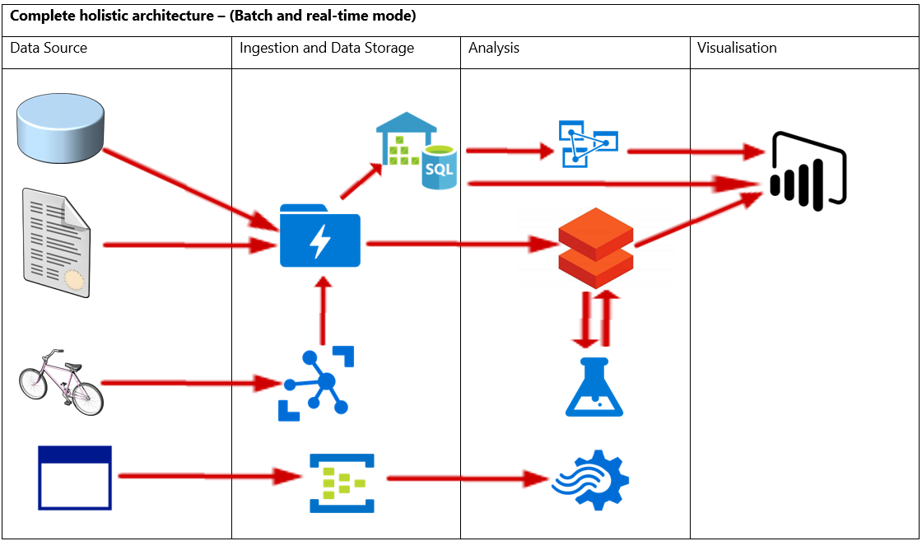
Lab review
Exercise 2 - Task 1: Create a high-level architecture to include a stream processing pipeline with Databricks

Slide 27
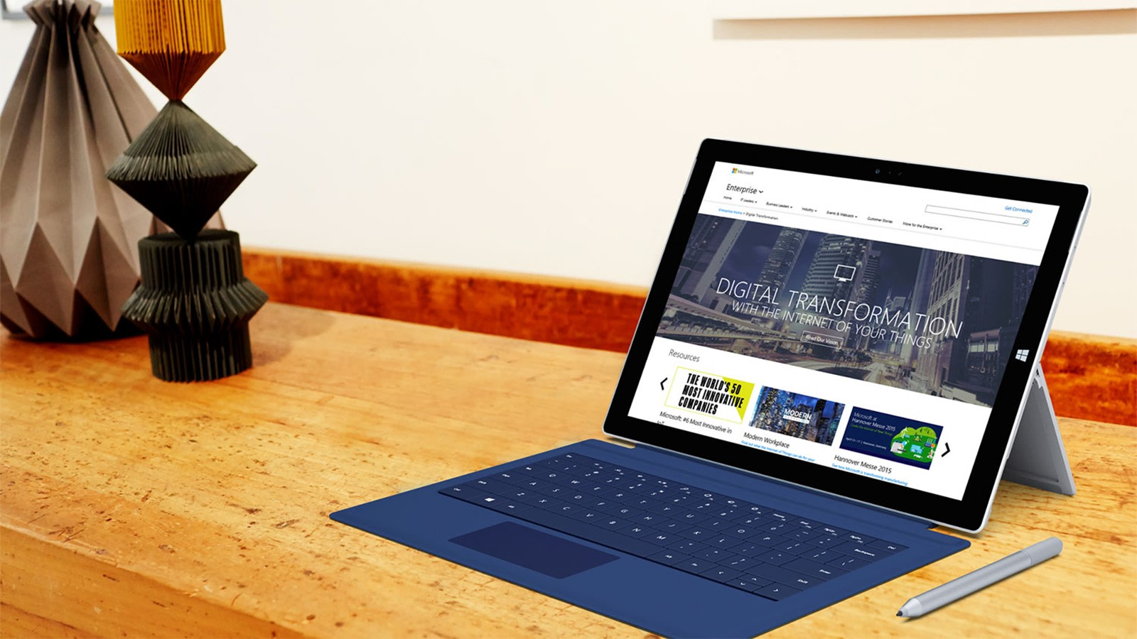
Next steps
Module Summary
In this module, you have learned about:
- Lambda architectures for a Real-Time Mode Perspective
- Architect a stream processing pipeline with Azure Stream Analytics
- Design a stream processing pipeline with Azure Databricks
- Create an Azure IoT reference architecture
After the course, consider visiting the Azure Reference Architecture site to view a wide range of architectures that can be implemented based on scenario.

